Slide 1
Business Expansion and Growth
Johnny Huang

Slide 2
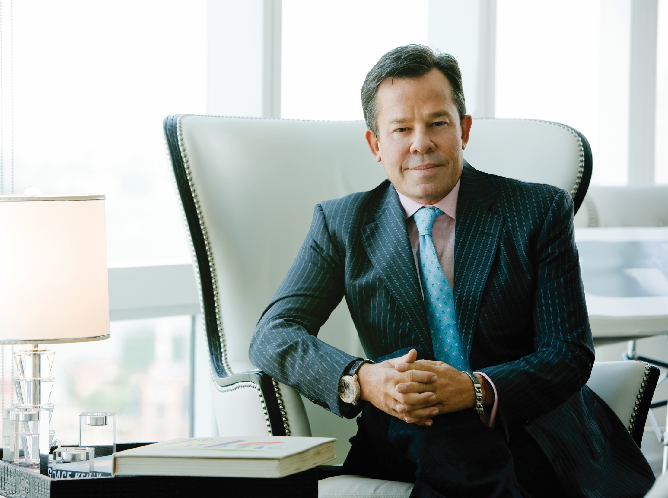
The proven system helps
the average who wants to do business to earn residual income

Slide 3
45 YEAR PLAN
2 TO 3 YEAR PLAN

Slide 4
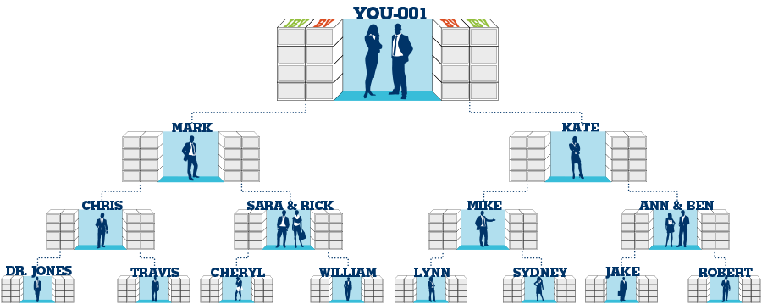
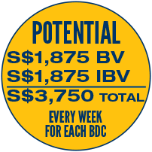
BV & IBV commissions are calculated weekly
5,000
5,000
3,600
3,600
2,400
2,400
1,200
1,200
1,200 total BV from your left and right = S$375
1,200 total IBV from your left and right = S$375
2,400 total BV from your left and right = S$375
2,400 total IBV from your left and right = S$375
3,600 total BV from your left and right = S$375
3,600 total IBV from your left and right = S$375
5,000 total BV from your left and right = S$750
5,000 total IBV from your left and right = S$750

Slide 5
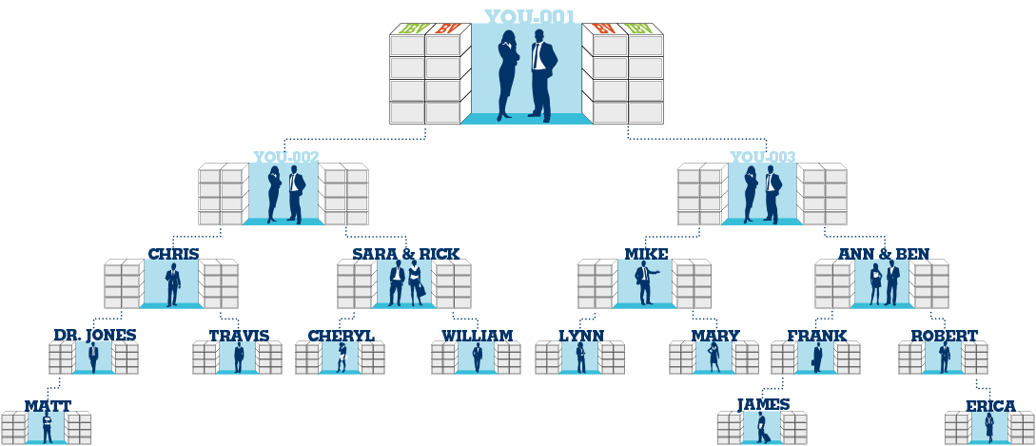
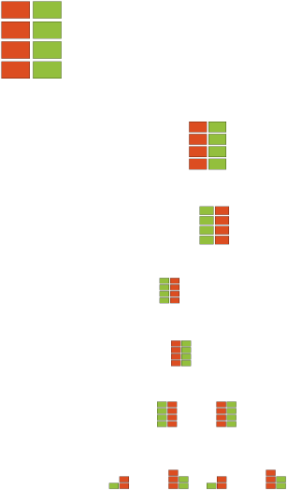
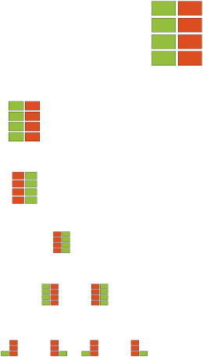
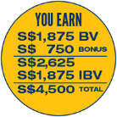
Open additional Business Development Centers to increase your commissions
200 BV
200 BV

Slide 6
BV+BV=residual income
Leader + Leader = Residual
Income
financial
freedom
time
freedom

Slide 7
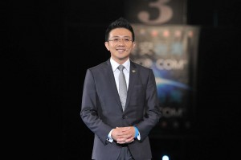
golden triangle

Slide 8
1.Are you a leader?
2.Do you have a system?

Slide 9
Leader
Leadership=Lead
Leadership=Educate

Slide 10
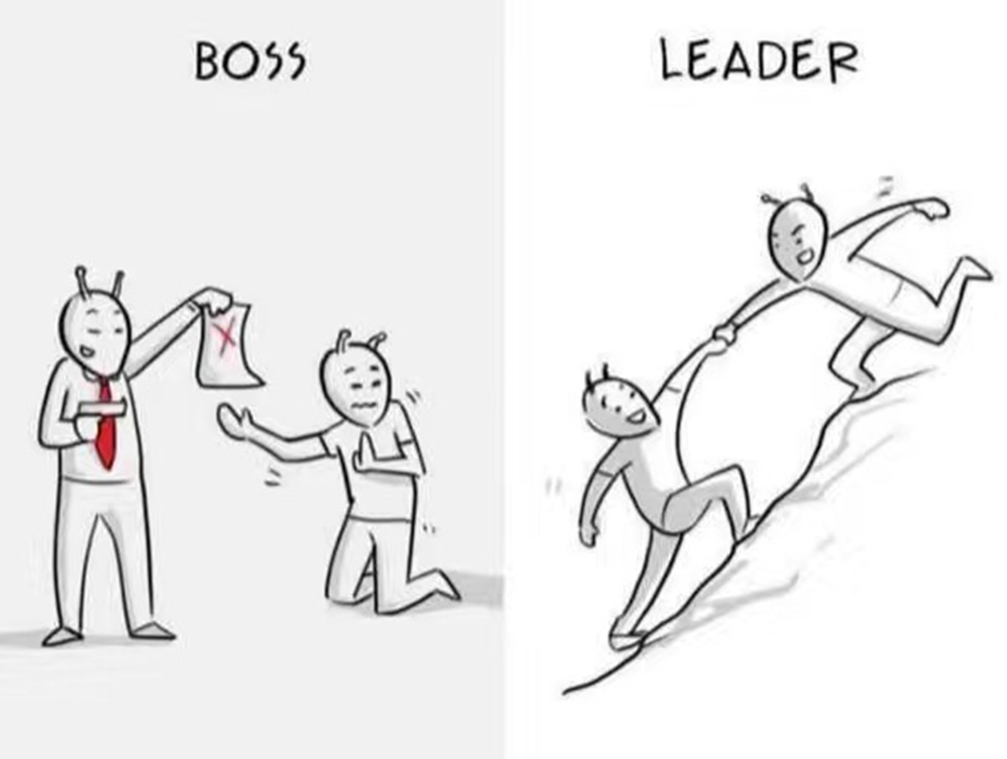
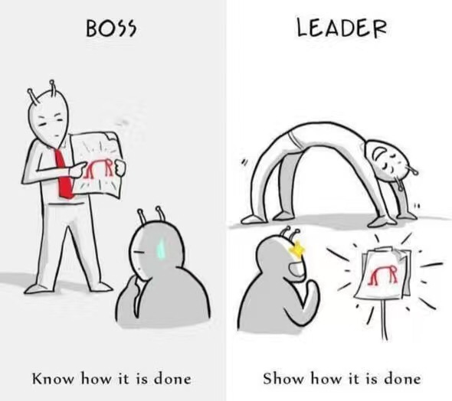
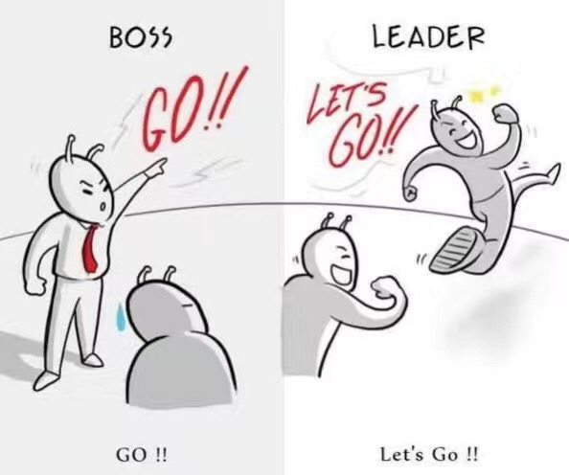

Slide 11
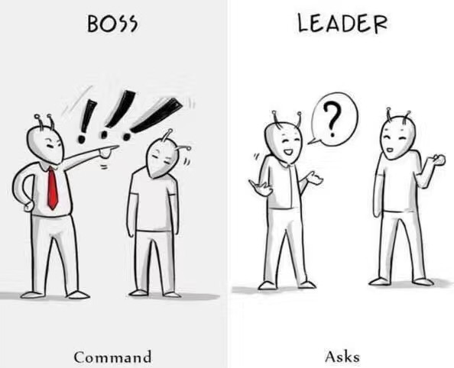
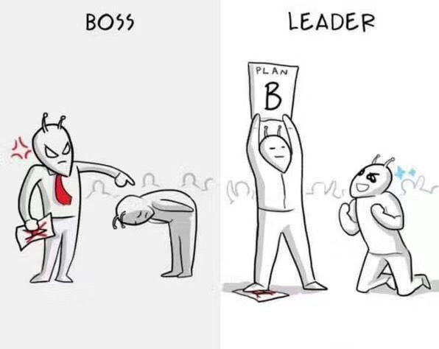

Slide 12
LEADER
LEADER
LEADER
LEADER
LEADER
LEADER
LEADER
LEADER
LEADER
LEADER
LEADER

Slide 13
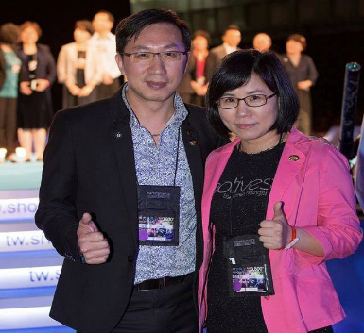
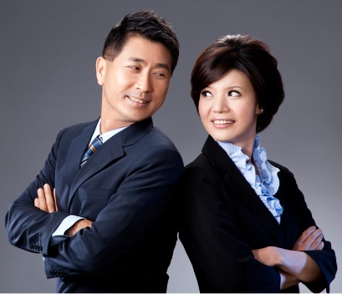
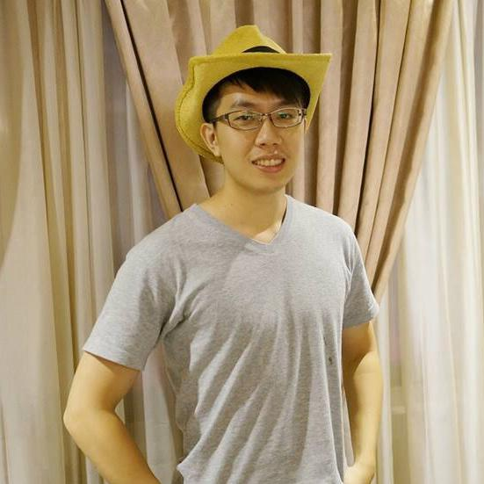
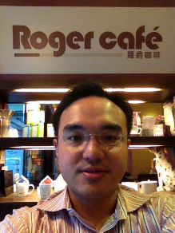
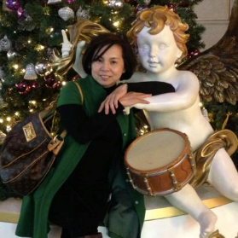
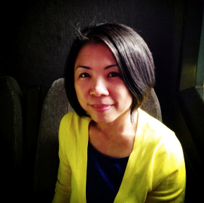
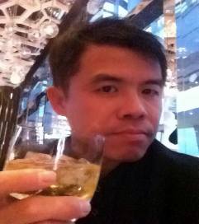
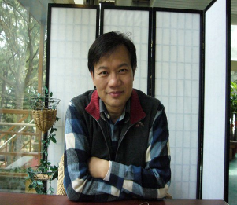
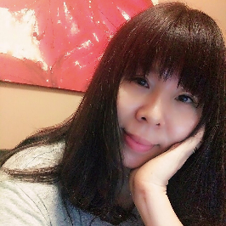
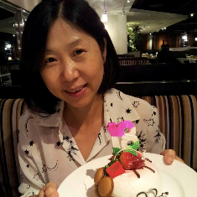
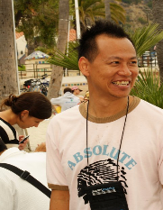
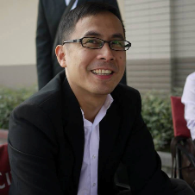
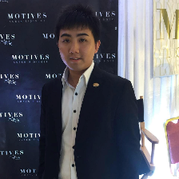
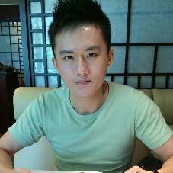
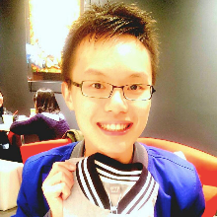
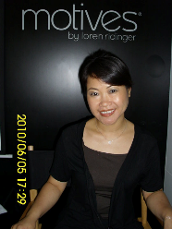
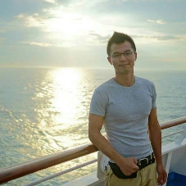
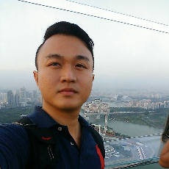
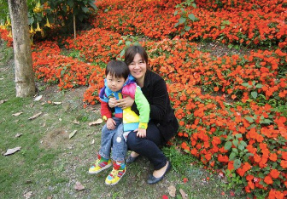
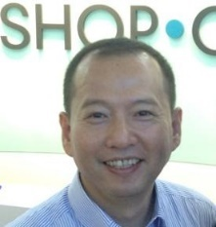
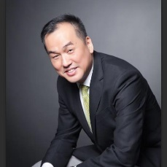
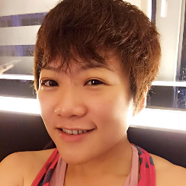
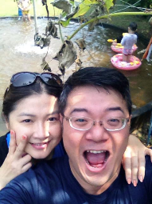
Executive
Supervising
Coordinator
National Supervising Coordinator
Director
林育世
罗歆宜
黄瀛谊
潘镜允&黄麟翔
蔡昌志&林孟涵
林书廷
Supervising Coordinator
吴辉荣
彭国定
冯纯慧
王旭凤
徐大钧
石国坪
黄彦凯
胡升鸿
黄致伦
Michelle(HK)
黄世桦
李晟嘉
黄映乔
孔令扬
Jerry Tay(SG)
杨慧音
杨立彬&郭雅芳

Slide 14
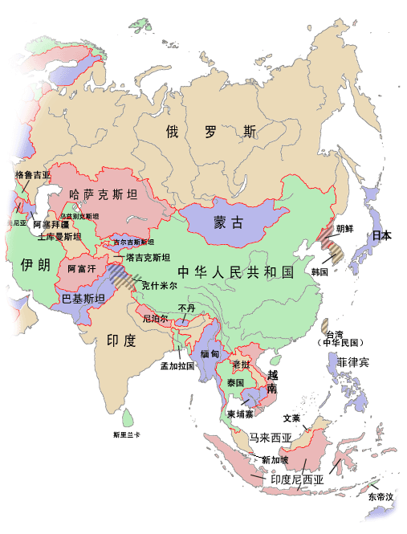
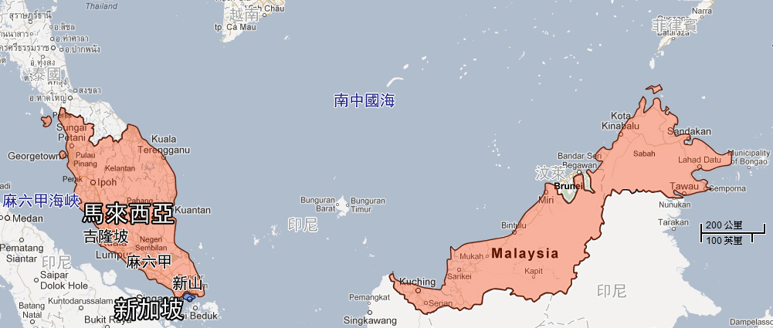

Slide 15
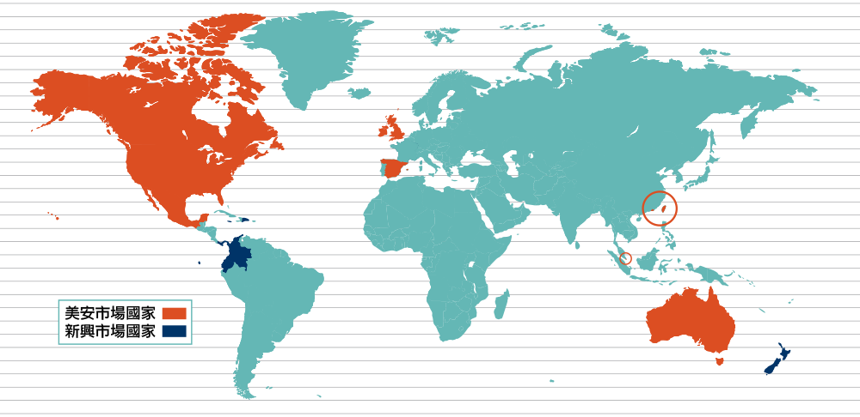

Slide 16
1：2：4：8 ：16：32：64：128：256
Residual income comes from…duplication

Slide 17
Key to a strong organisation
Do you have a “system”?
If you don't have a system
and have a big team, it is actually
a disaster!!

Slide 18
What are the procedure (steps) of recruiting?
1.List names
2.Call
9.Join
Shop.com
Follow up (next event)
meeting after meeting
3.First meeting
8.Join coring
4.HBP
7.Handle
objections
6.GMTSS
5.UBP

Slide 19
Follow-up -- in accordance with “system”
Objective:
Honour: MUFO,SABP, Challenges
Practice: employment, income
Record:Learning (audio recordings), B5 test, retail, recruit
Meeting: GMTSS, coring, Convention
Groups: LINE, FB, WeChat
Dream: original intention, desire

Slide 20
CORING
GMTSS
Master UFO
Challenges
Don't challenge the system
Convention
DREAM

Slide 21
THE INCOME LEVELS MENTIONED IN THIS PRESENTATION ARE FOR ILLUSTRATION PURPOSES ONLY. THEY ARE NOT INTENDED TO REPRESENT THE INCOME OF ANY TYPICAL MARKET SINGAPORE ® UNFRANCHISE® OWNER, NOR ARE THEY INTENDED TO REPRESENT THAT ANY GIVEN UNFRANCHISE® OWNER WILL EARN INCOME IN THAT AMOUNT. THE SUCCESS OF ANY MARKET SINGAPORE ® UNFRANCHISE® OWNER WILL DEPEND UPON THE AMOUNT OF HARD WORK, TALENT, AND DEDICATION WHICH HE OR SHE DEVOTES TO BUILDING HIS OR HER MARKET SINGAPORE® BUSINESS.

Slide 22
THE INCOME LEVELS MENTIONED IN THIS PRESENTATION ARE FOR ILLUSTRATION PURPOSES ONLY. THEY ARE NOT INTENDED TO REPRESENT THE INCOME OF ANY TYPICAL MARKET SINGAPORE ® UNFRANCHISE® OWNER, NOR ARE THEY INTENDED TO REPRESENT THAT ANY GIVEN UNFRANCHISE® OWNER WILL EARN INCOME IN THAT AMOUNT. THE SUCCESS OF ANY MARKET SINGAPORE ® UNFRANCHISE® OWNER WILL DEPEND UPON THE AMOUNT OF HARD WORK, TALENT, AND DEDICATION WHICH HE OR SHE DEVOTES TO BUILDING HIS OR HER MARKET SINGAPORE® BUSINESS.

Slide 23
THE INCOME LEVELS MENTIONED IN THIS PRESENTATION ARE FOR ILLUSTRATION PURPOSES ONLY. THEY ARE NOT INTENDED TO REPRESENT THE INCOME OF ANY TYPICAL MARKET SINGAPORE ® UNFRANCHISE® OWNER, NOR ARE THEY INTENDED TO REPRESENT THAT ANY GIVEN UNFRANCHISE® OWNER WILL EARN INCOME IN THAT AMOUNT. THE SUCCESS OF ANY MARKET SINGAPORE ® UNFRANCHISE® OWNER WILL DEPEND UPON THE AMOUNT OF HARD WORK, TALENT, AND DEDICATION WHICH HE OR SHE DEVOTES TO BUILDING HIS OR HER MARKET SINGAPORE® BUSINESS.

Slide 24
The guarantee of residual income
Accelerator
Notes:
10 times the acceleration

Slide 25
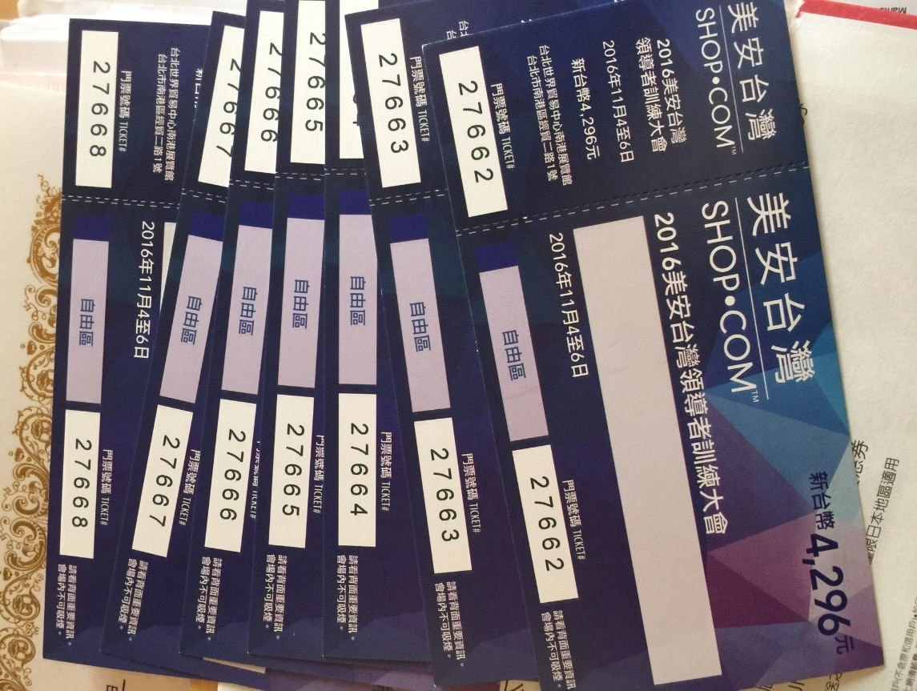
The highest return on investment in history
Magic tool to quickly
integrate the organisation

Slide 26
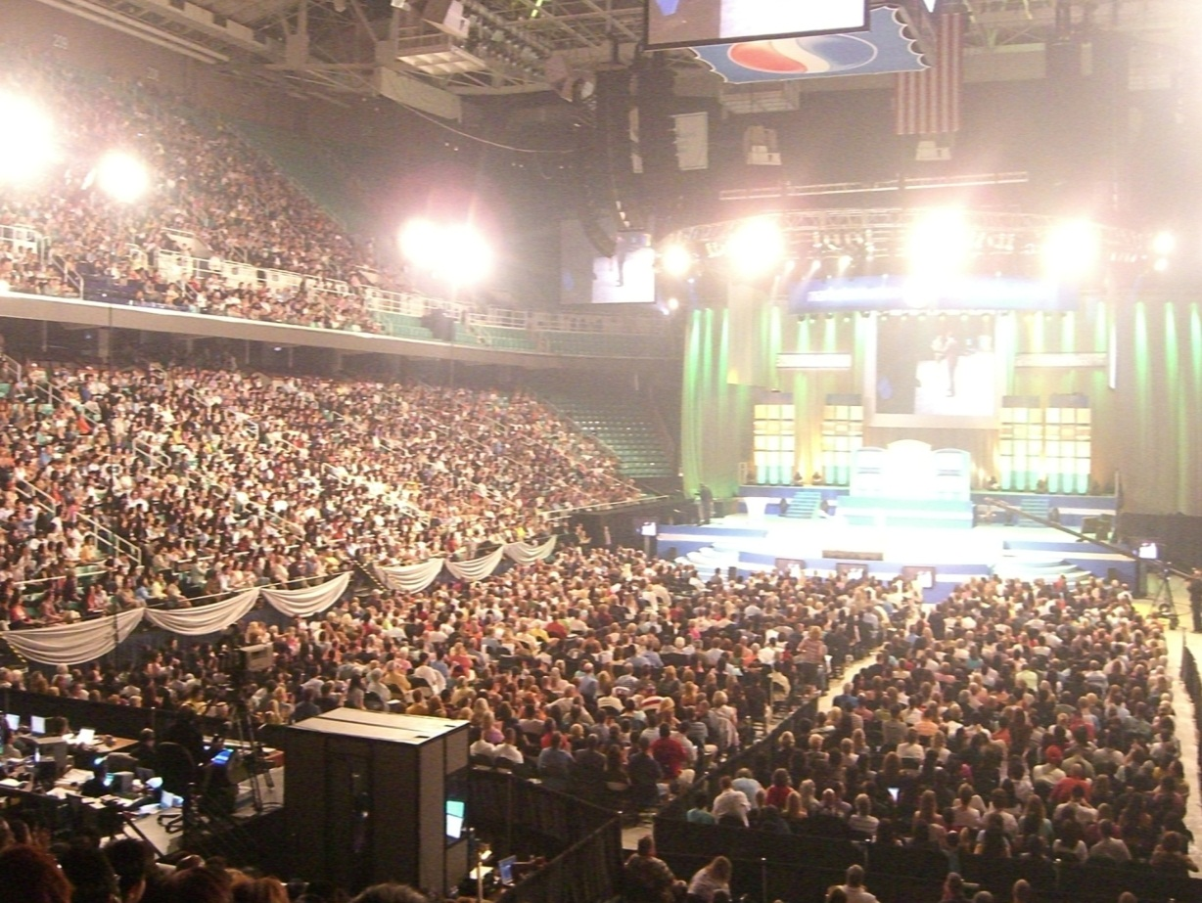
Power of tickets
Income
BV, IBV
People
Ticket

Slide 27
First Convention (2007.04)
20 people
60 tickets
40 tickets
Second Convention (2007.10)
95 people
99 tickets
90 tickets
First Convention(2008.04)
120 tickets
115 tickets
120 people
First Convention(2008.10)
180 tickets
200 tickets
170 people
First Convention(2009.04)
300 people
280 tickets
300 tickets
Buy tickets.Sell tickets.Forfeit tickets

Slide 28
First Convention (2007.4)
60 tickets
40 tickets
20 people
Big Secret

Slide 29
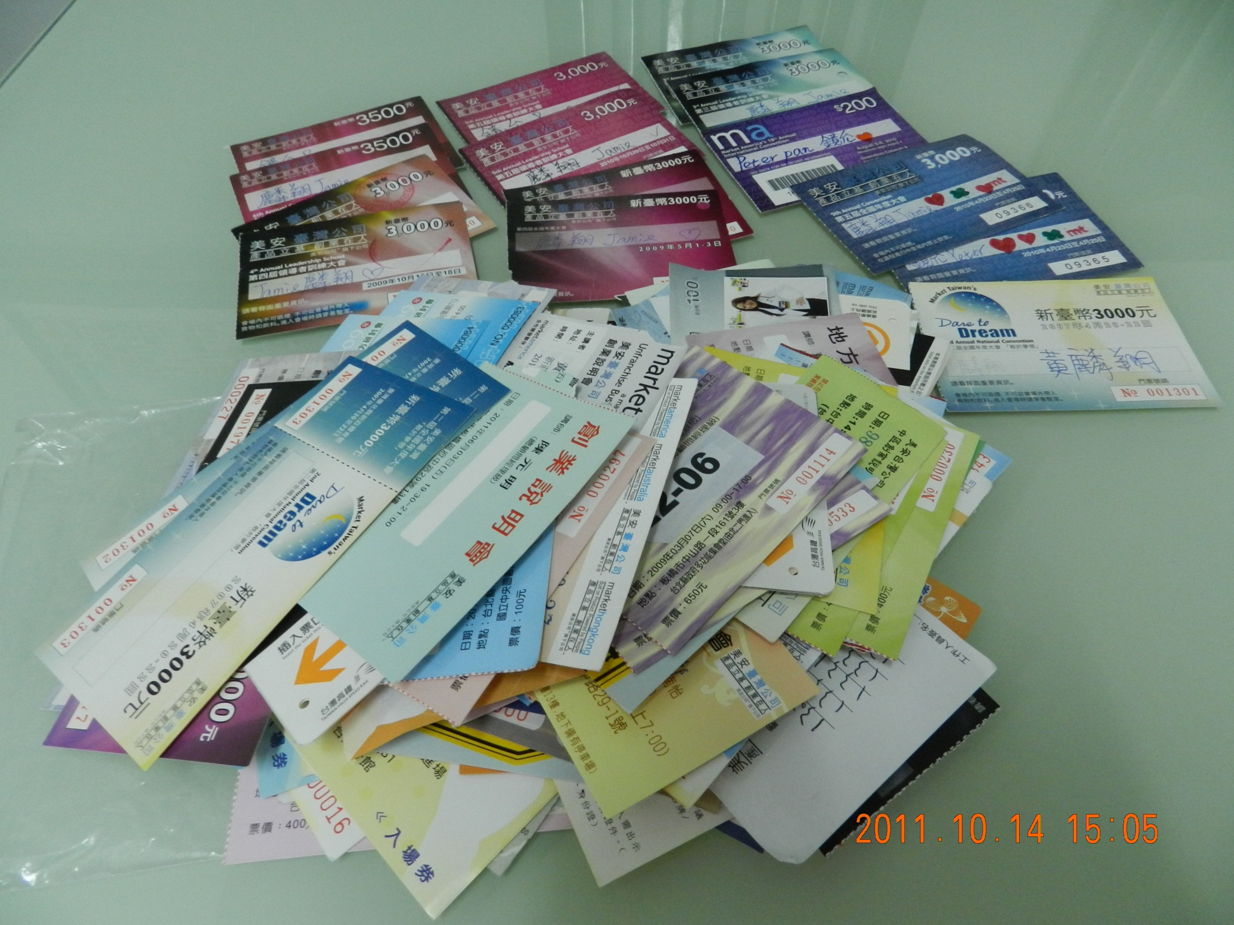

Slide 30
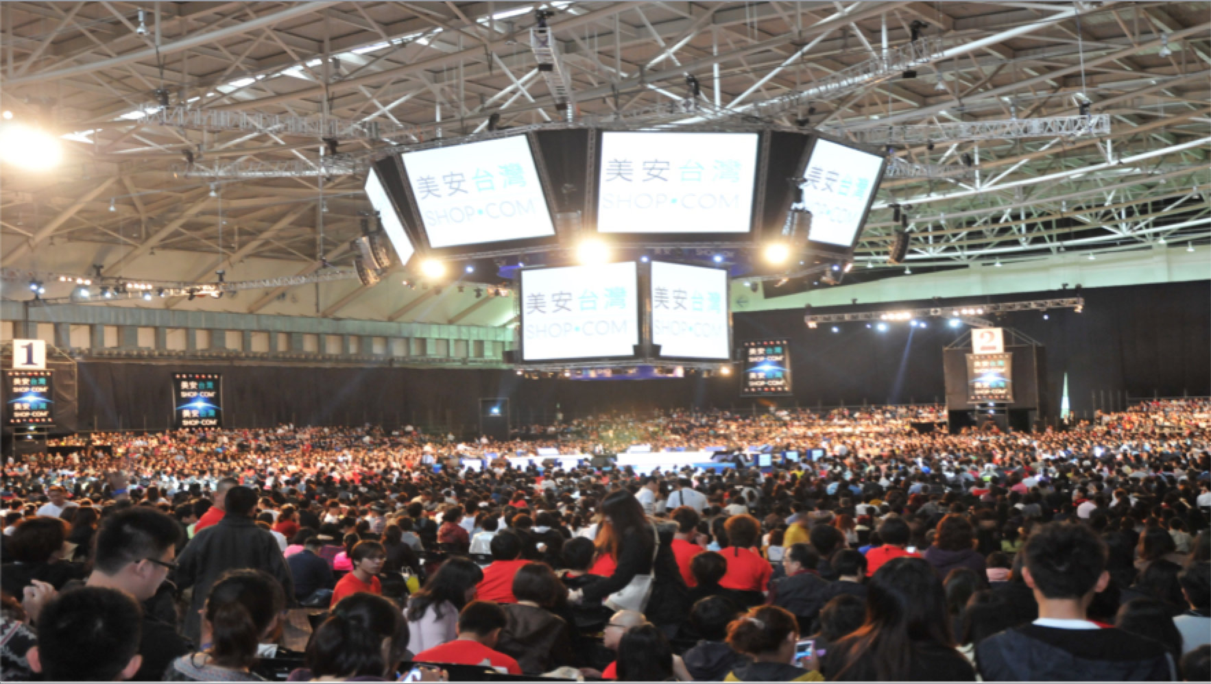
Self assess progress every six months
The number of tickets you buy decides your second half year’s income
You are not selling tickets but the belief behind them

Slide 31
How to catch the beautiful butterflies?

Slide 32
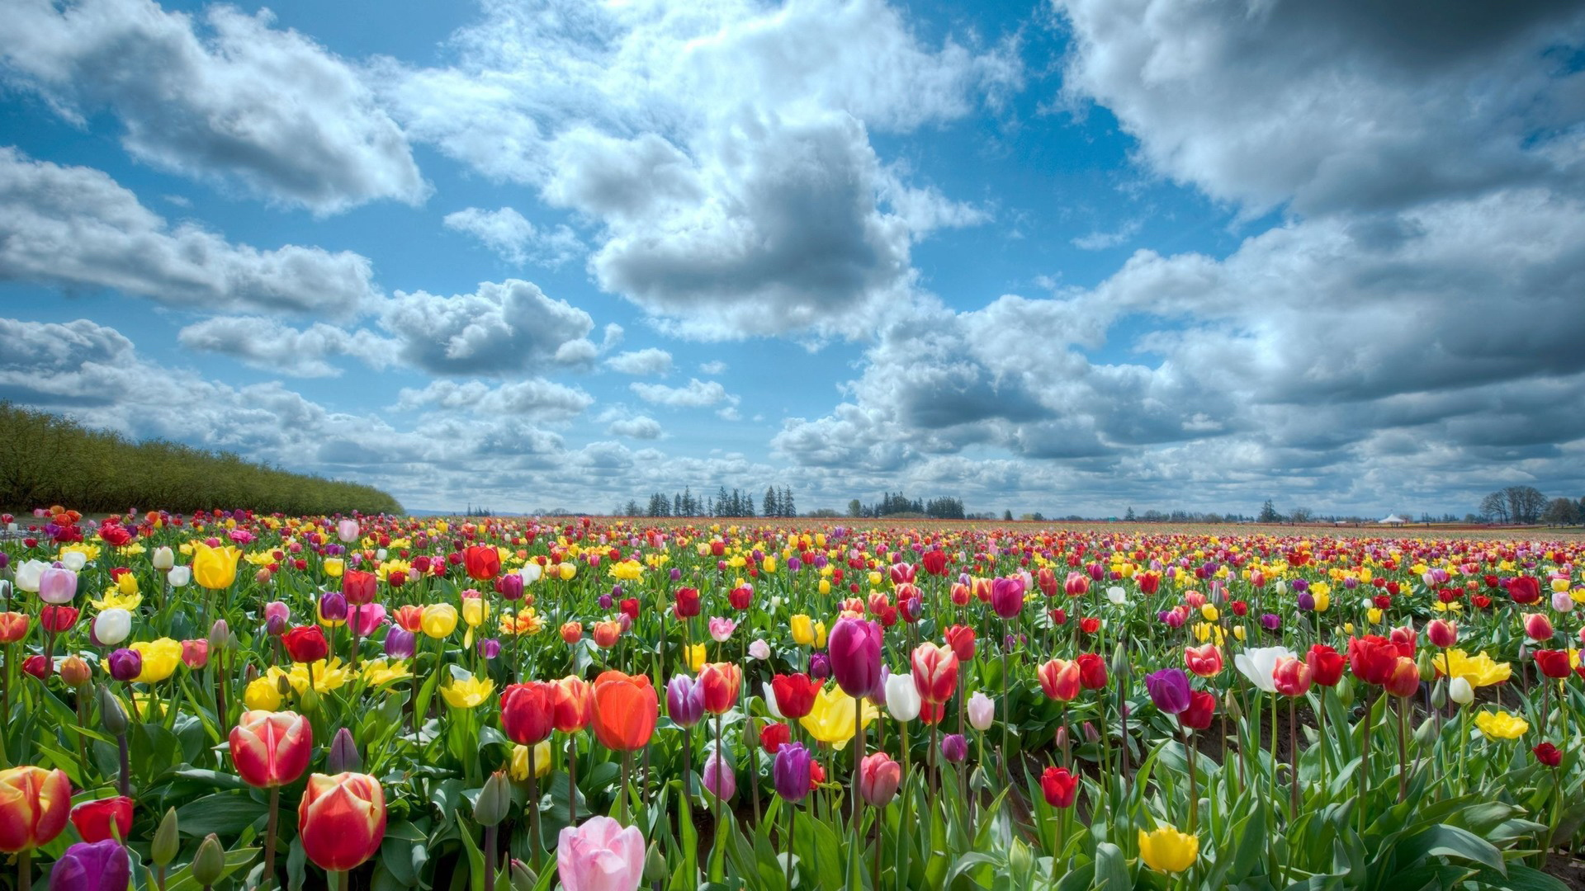
Butterflies will come when flowers in efflorescence.
Flair will never be undiscovered if the owner of it is the one of real talents

Slide 33
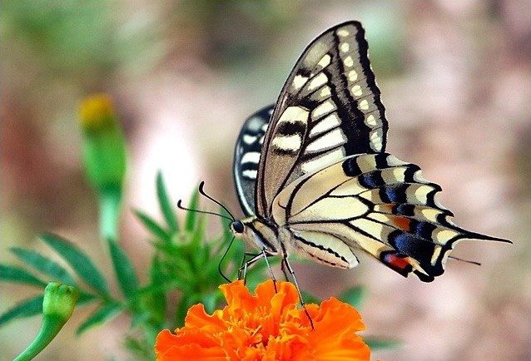
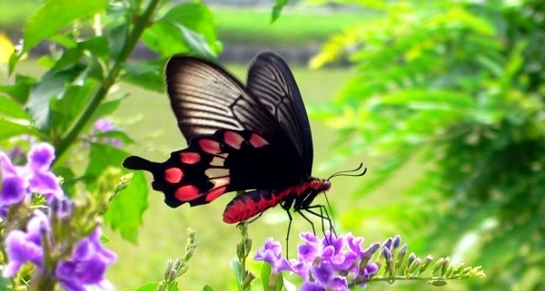

Slide 34
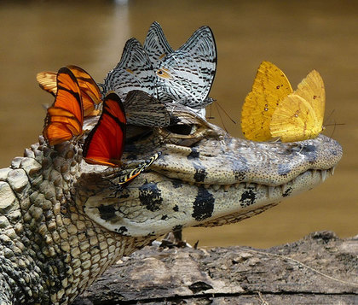
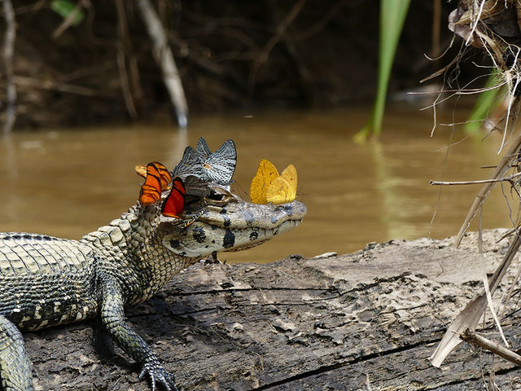

Slide 35
Virtue is not left to stand alone.He who practices it will have neighbours
-----<The Analects of Confucius>

Slide 36
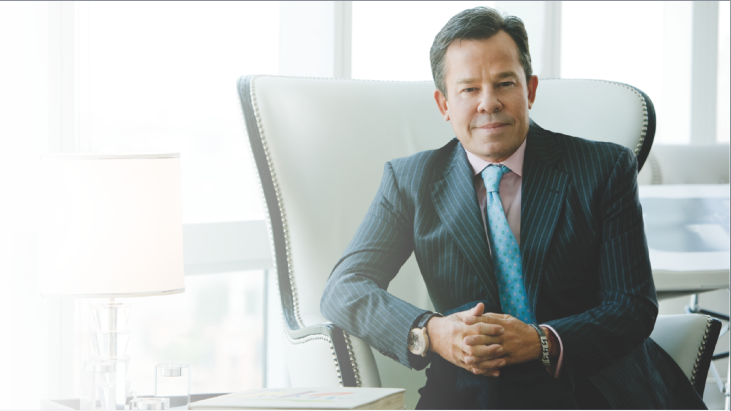
Lead by example
We must succeed,so others can achieve their dreams!
-JR Ridinger

Slide 37
The sky’s
The limit!
There is no limit to the sky

